Slide 1
Smart Lights and Fans
By Shaswat Mistry

Slide 2

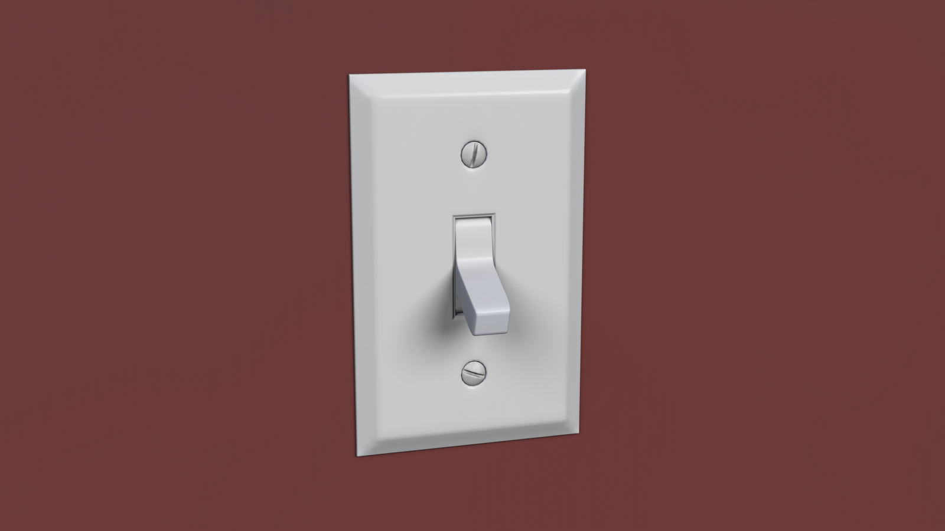
Why may we need such a system?
As we may have noticed many times in the past, we forget to switch off the lights and fans whilst exiting a room, and leave them in that state for hours at end at times, which wastes a lot of energy.
Since it also is quite a cumbersome task, it doesn’t hurt to automate it with a cheap solution!
This Photo by Unknown Author is licensed under CC BY

Slide 3
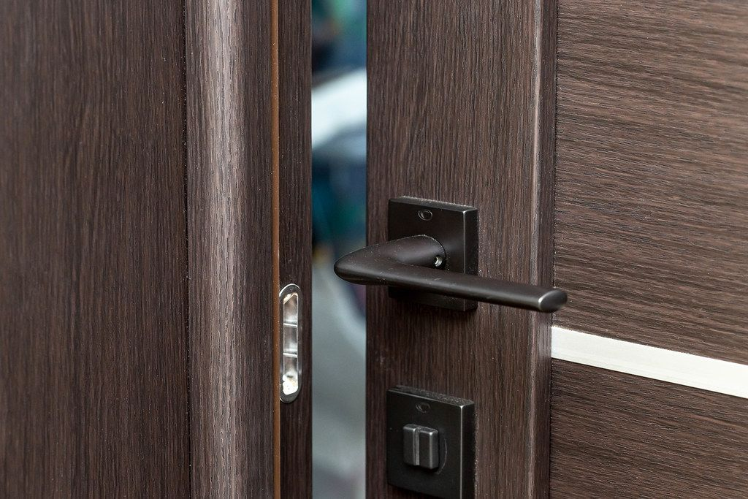
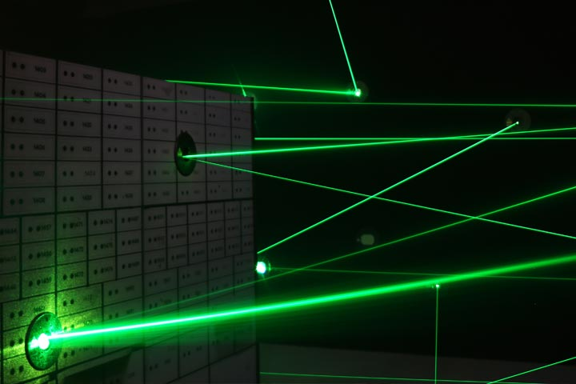
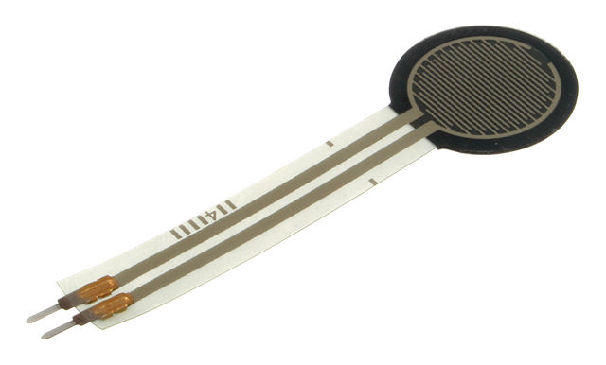
Now how will we know if a person is in the room?
The simplest solution, consists of just two force dependent resistors, basically, integral components of a rudimentary pressure plate!
The simplest way to put it, is to place them spaced one just on the doorway, and one further inside.
Now the reason for not using light tripwires is quite simple, doors are their mortal enemy, for small rooms, where the tripwires may simply get blocked by the door. But in case there is a long enough route, two light tripwires are more accurate at determining entry and exit.
This Photo by Unknown Author is licensed under CC BY-SA
This Photo by Unknown Author is licensed under CC BY-NC
This Photo by Unknown Author is licensed under CC BY

Slide 4

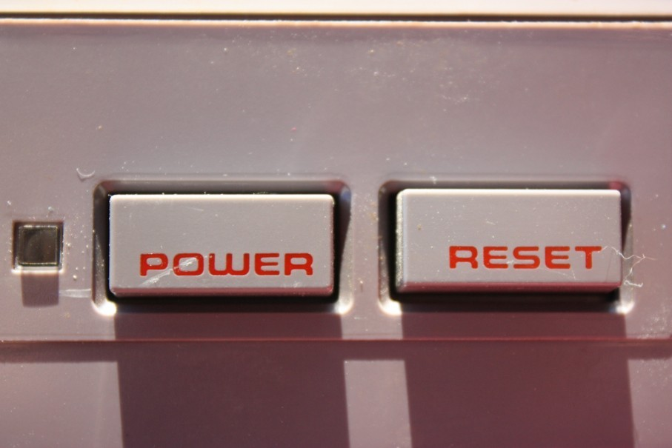
What do we do with the number of people in the room?
Now, the objective, is to, in some time, switch off the fan and lights, if they are on to begin with, in case the count of people in the room is zero!
We also need to provide a button (inside the room) to set the counter of people to 1, in case there is an issue with counting, and it registers zero people when there is more than zero people in the room.
This Photo by Unknown Author is licensed under CC BY-SA-NC

Slide 5
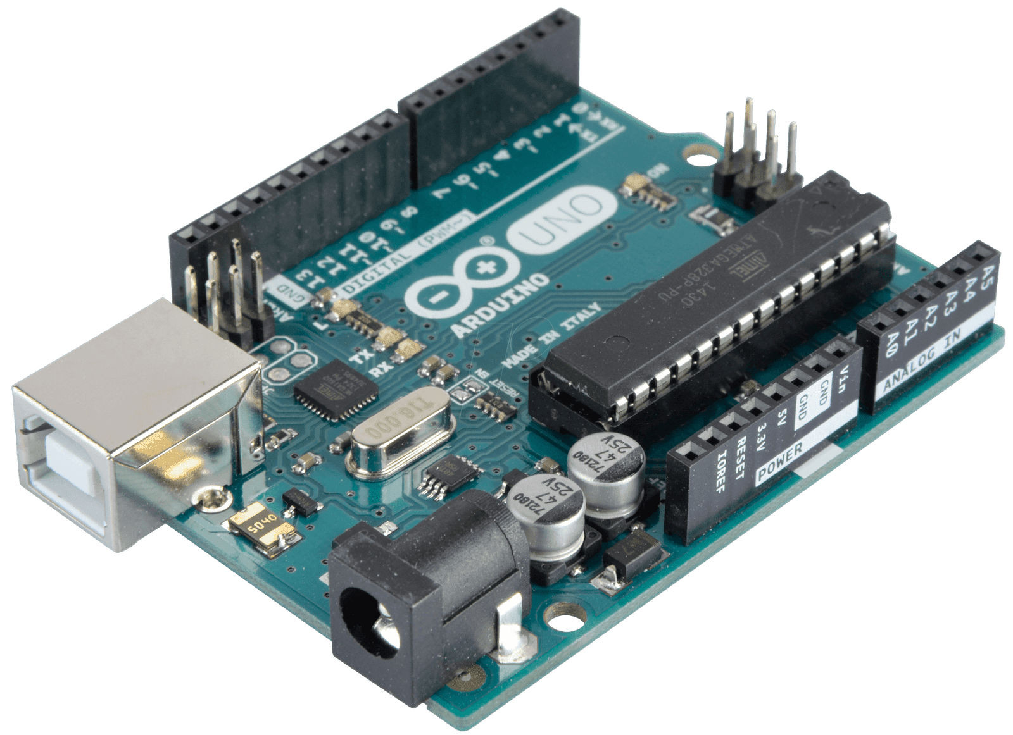

So what are the components we need?
An Arduino to control the switches and process the information provided by sensors.
Switches which can be controlled by the Arduino employed.
The pressure plates (made with force dependent resistors) or LASER tripwires.
And why not add mobile control of these switches at the same time, to remotely be able to control the lights and add other features??!
This Photo by Unknown Author is licensed under CC BY-SA-NC
This Photo by Unknown Author is licensed under CC BY-SA-NC

Slide 6
Flow of logic:
Count number of people in the room, and state of each switch
If count is not 0
If count=0
Start a timer with say, 5 minutes time
Keep Checking
If count increases
If count is still =0
Switch every on switch to off

Slide 7
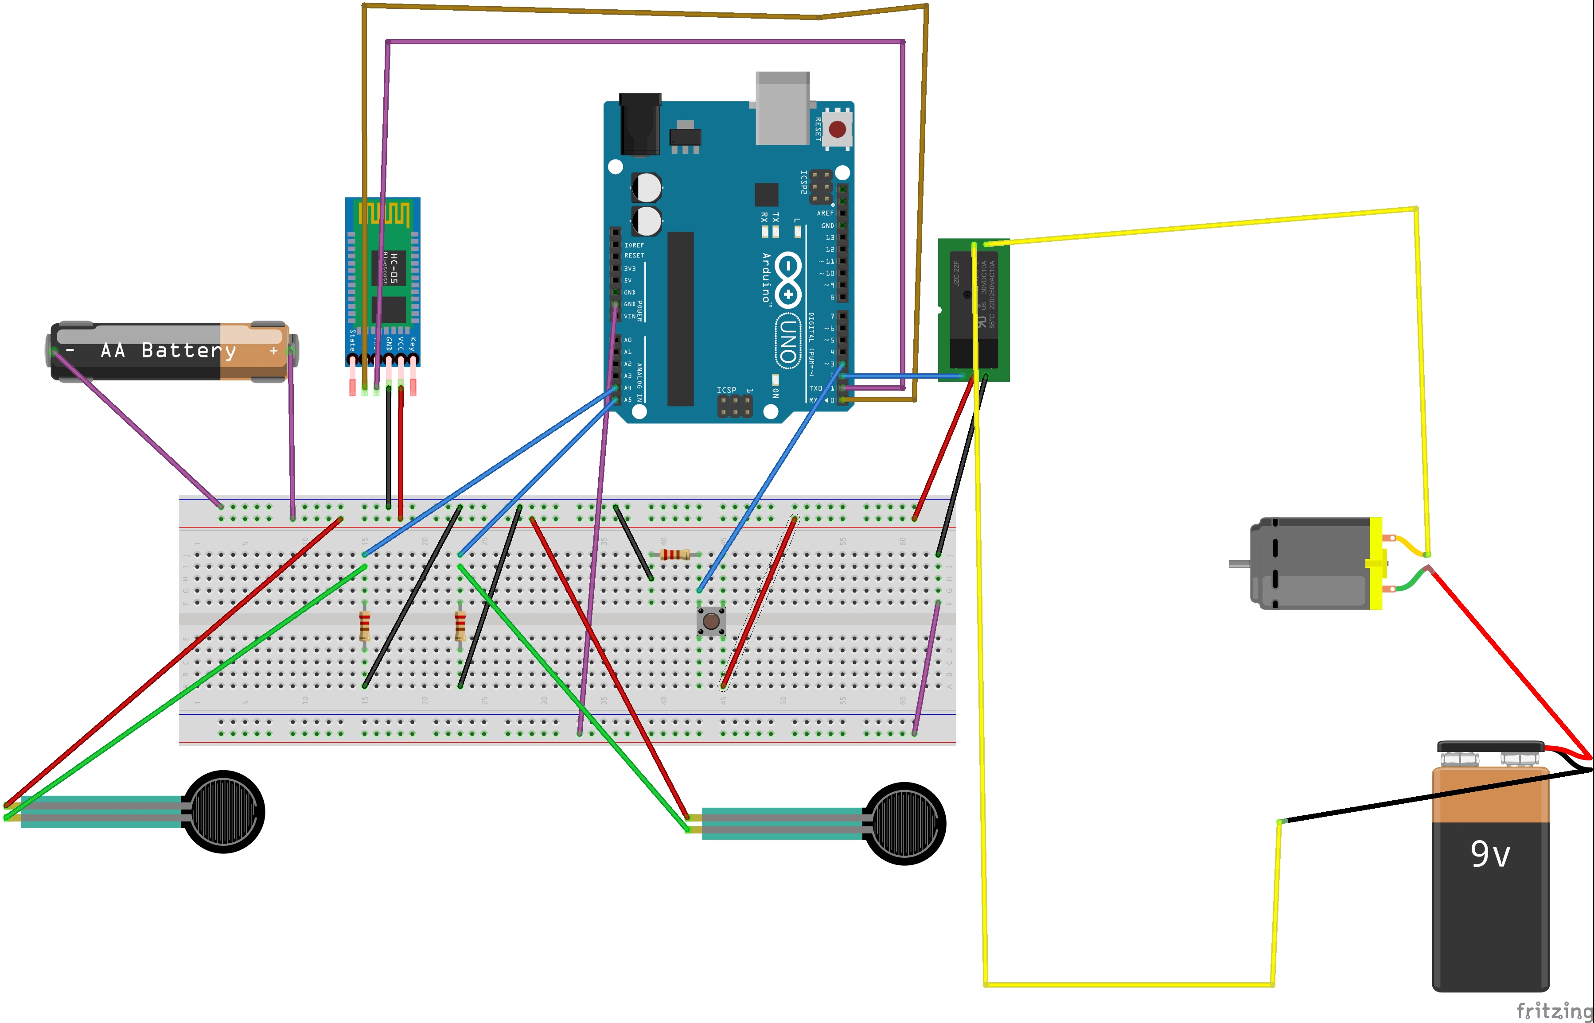
Bluetooth Module
Relay
Relay
Power
Bluetooth module
Low voltage
Lights/fans
Fan/lights
Setting button
High Power
Power
Pressure Sensors
Pressure Plates

Slide 8
Features to add to code:
In case the count ever drops below zero in case of a counting error (say, someone was standing on a plate and another person walked by) the code should set it back to zero.
The ability to override the switches via Bluetooth, and anytime the Bluetooth module is used the count gets set to 1 if the count is zer0.
The ability to force a switch to stay ON via phone.

Slide 9
Overview:
The system can count the number of people in the room, to know whether to switch off lights and fans or not.
It has a timer, to ensure the appliances are on in case the time of leave is short.
The button which sets the number of people in the room back to 1 is inside the room, to ensure the system can get corrected in case of a counting error.
And an added benefit, the ability to switch on and off appliances with Bluetooth and a phone, and adding master control via the phone too.

Slide 10
THANK YOU!!

